Slide 1
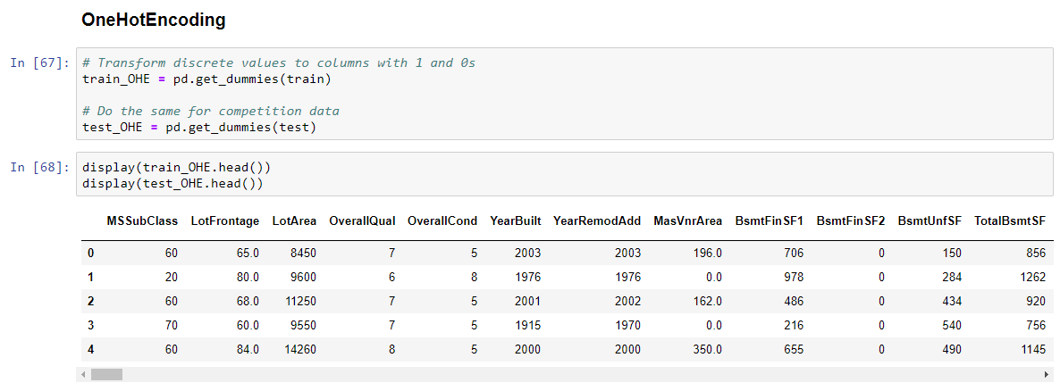

Slide 2
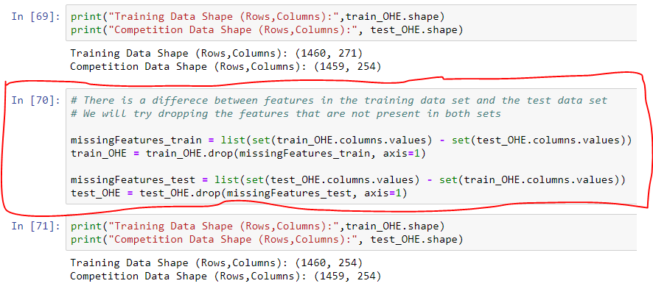

Slide 3
Linear Regression
Lasso
Ridge
Logistic Regression
Decision Tree
Random Forest
XGBoost
Score Summary
Hypothesis Testing
1. Chi-Square Test

